Slide 1
THIRD EYE FOR BLIND ULTRASONIC VIBRATOR GLOVE USING IoT
SURI PRA2232017010034
RUBAN KUMAR RA2232017010006
FAREVZ RA22320170100005

Slide 2
ABSTRACT
The “Third Eye for Blind with Vibrating Ultrasonic Glove”, is designed to help the blind to overcome the lack of visual sense, by using other senses like sound and touch. It uses audio and vibration signals to notify the user about upcoming hurdle. As the distance between glove and obstacle decreases, frequency of both audio and vibration signals increases. Thus the system helps to ease the navigation process for the needy.
The system uses Atmega-328 microcontroller, which is a high performance 8-bit AVR RISC-based microcontroller. It has 32KB of ISP flash memory with read-while-write capabilities, as well as 1KB EEPROM, 2KB SRAM. It also has features like, 23 general purpose I/O lines, 32 general purpose working registers and three adjustable timer/counters with compare modes. For sensing the distance the system uses a HC-SR04, a Ultrasonic Range Finder Distance Sensor Module. The sensor module is designed to measure the distance using the principle of SONAR or RADAR, of using ultrasonic wave to determine the distance of an object. The system also consist a buzzer to generate an alarm sound and a motor to generate vibration signals.

Slide 3
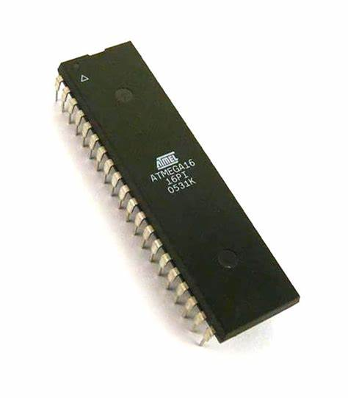
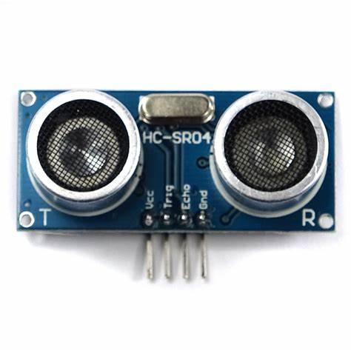
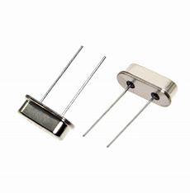
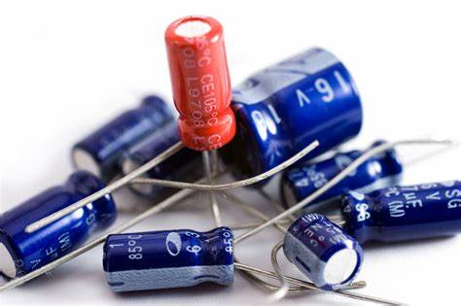
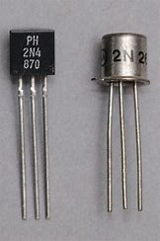
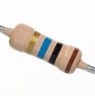
HARDWARE SPECIFICATIONS
Atmega Microcontroller ULTRASONIC SENSOR CRYSTAL OSCILLATOR
RESISTORS CAPACITORS TRANSISTORS

Slide 4
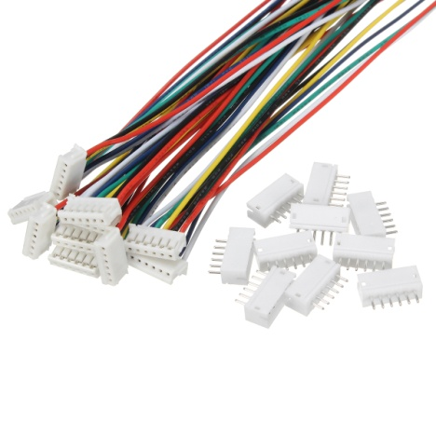
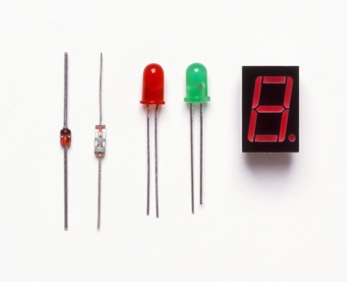
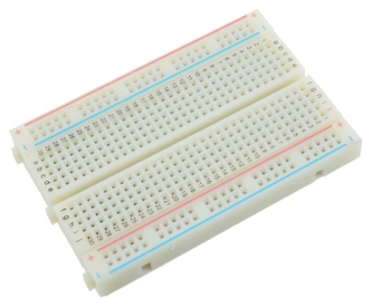
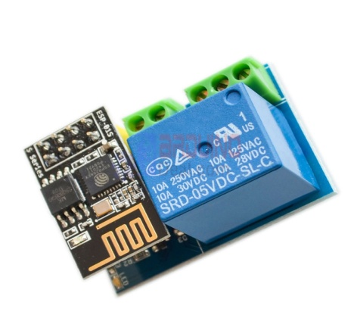
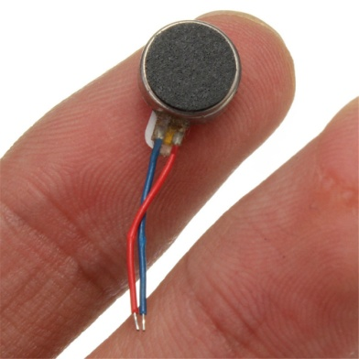
HARDWARE SPECIFICATIONS
CABLES & CONNECTORS DIODES & LED PCB & BREADBOARDS
PUSH BUTTONS / SWITCH VIBRATOR MOTOR

Slide 5
SOFTWARE SPECIFICATION
ARDUINO COMPLIER
LANGUAGE :C

Slide 6
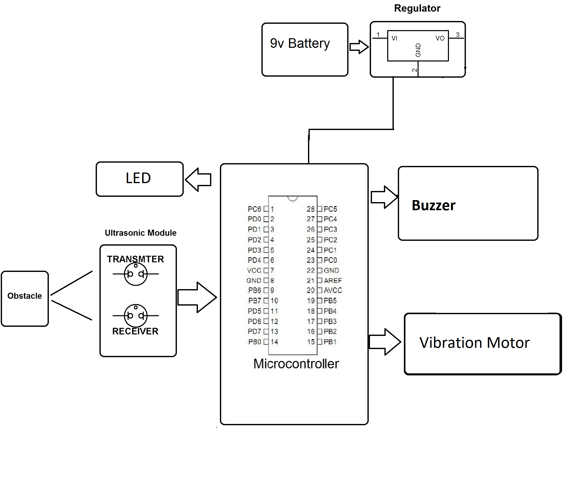
BLOCK DAIGRAM

